Slide 1
Apache Atlas: Data Governance
Partner Solutions
July 2015

Slide 2
Agenda
Overview
Enterprise Goals
Data Governance Initative
Atlas
Feature tour
Roadmap
UI Tour
Demo
Example: Sqoop
Walk through step
Search Tables / Tags
Notes:
We have a lot to cover, want to apologize in advance

Slide 3
Enterprise Data Governance Goals
GOAL: Provide a common approach to data governance across all systems and data within the organization
Transparent Governance standards & protocols must be clearly defined and available to all
Reproducible Recreate the relevant data landscape at a point in time
Auditable All relevant events and assets but be traceable with appropriate historical lineage
Consistent Compliance practices must be consistent
Visualization
& Dashboards
Business Analytics
Governance Framework
ETL/DQ
BPM
MDM
ERP
ARCHIVE
CRM
SCM
Notes:
A data governance framework in any organization comprises a combination of people, process and technology that are in place to establish decision rights and accountabilities for information. A governance policy defines who can take what actions with what information, and when, under what circumstances, using what methods.
The technology goals for a data governance framework are to provide a platform for a common approach across all systems and data within the organization, Explicitly they need to be:
- Transparent: Governance standards & protocols must be clearly defined and available to all
- Reproducible: Recreate the relevant data landscape at a point in time
- Auditable: All relevant events and assets but be traceable with appropriate historical lineage
- Consistent: Compliance practices must be consistent

Slide 4







Data Governance Initiative for Hadoop
Visualization
& Dashboards
Data Governance Initiative
TWO Requirements
Hadoop must snap in to the existing frameworks and be a good citizen
Hadoop must also provide governance within its own stack of technologies
Business Analytics
Apache Pig
Apache Hive
Apache HBase
Apache Accumulo
Apache Solr
Apache Spark
Apache Storm
Common Governance Framework
ETL/DQ
BPM
MDM
1
°
°
°
°
°
°
°
°
°
°
°
°
°
°
°
°
°
°
°
°
°
ERP
ARCHIVE
A group of companies dedicated to meeting these requirements in the open
CRM
SCM
Major Bank
Notes:
Consistent with our approach, Hortonworks recently led the development Data Governance Initiative which brings together industry experts from some of the largest enterprise, traditional vendors and Hadoop experts to address governance within Hadoop.
The members have already defined a comprehensive solution for data governance in Hadoop that will provide the base functions of metadata services, deep audit store and an advanced policy rules engine, but also and more importantly, the solution will interoperate with and extend existing third-party data governance and management tools by shedding light on the access of data within Hadoop.
This approach allows organizations to apply comprehensive governance policy across their data.
In order to provide these functions for Hadoop, much work will need to be accomplished throughout all of the Hadoop projects. The initiative is unique in that it is not a spot solution, but will build on top of existing projects such as Apache Falcon for data lifecycle management and Apache Ranger for global security policies.
The founding members of this initiative include, Aetna, Target, Merck, SAS and Hortonworks and many more are lined up to contribute. This is a broad community based initiative set to deliver the right features for the right requirements and is perfectly representative of the Hortonworks open community approach.

Slide 5
Apache Atlas Overview
We Do Hadoop

Slide 6
Apache Atlas Vision
Metadata Services
Flexible Knowledge Store
Business Catalog / Operational Data
Search & Proscriptive Lineage
Centralized location for all metadata within HDP
Interface point for Metadata Exchange with platforms outside of HDP.
Metadata will enrich every component
Hive – Complete lineage, every HiveQL tracked
Ranger – Tag or Attribute security ABAC
Falcon – Business Taxonomy
Hive
Ranger
Falcon
Kafka
Storm
Apache Atlas
Notes:
One of the most important and challenging goals is consistency and when we inspect implementation of data governance for a Hadoop implementation this consistency seems almost impossible.
While there are constructs within the various Hadoop related projects to aid governance, there is no single, consistent approach to implementation/architecture of this important framework. Disparate tools, such as HCatalog, Ranger and Falcon provide pieces of the overall solution, but are not holistic across the stack in approach.
Further, with Hadoop gaining traction in the enterprise, it has only recently been asked to integrate with existing frameworks such as operations, security and now governance. It is now a foundational concern.

Slide 7
Apache Atlas Capabilities: Overview
Data Classification
Import or define taxonomy business-oriented annotations for data
Define, annotate, and automate capture of relationships between data sets and underlying elements including source, target, and derivation processes
Export metadata to third-party systems
Centralized Auditing
Capture security access information for every application, process, and interaction with data
Capture the operational information for execution, steps, and activities
Search & Lineage (Browse)
Pre-defined navigation paths to explore the data classification and audit information
Text-based search features locates relevant data and audit event across Data Lake quickly and accurately
Browse visualization of data set lineage allowing users to drill-down into operational, security, and provenance related information
Security & Policy Engine
Rationalize compliance policy at runtime based on data classification schemes
Advanced definition of policies for preventing data derivation based on classification (i.e. re-identification)
Healthcare
HIPAA
HL7
Financial
SOX
Dodd-Frank
Custom
CWM
Retail
PCI
PII
Other
REST API
Services
Apache Atlas
Search
Lineage
Exchange
Knowledge Store
Policy Engine
Taxonomies
Policy Rules
Type-System
Models
Data Lifecycle Management
Audit Store
Security
Notes:
Roll tax into data disco

Slide 8
Sample Use Case: ETL Offload
Load Wrapper
RDMS
Hive:
Landing
Hive:
CTAS
Sqoop
Business Catalog
Metadata
Reporter via REST API
Atlas
Traditional
EDW
New ETL
Hadoop
Notes:
Show – clearly identify customer metadata. Change
Add customer classification example – Aetna – make the use case story have continuity. Use DX procedures to diagonsis
** bring meta from external systems into hadoop – keep it together

Slide 9
Hive Integration
Hive Bridge
(Client)
Hive Hook
(Post-execution)
REST API
Apache Atlas
Notes:
Specify
Metrics – Time / Success /user /etc…
Contrast with Ranger plug-in – pre execute

Slide 10

Governance Ready Certification Program
Discovery
Tagging
Prep / Cleanse
ETL
Governance
BPM
Self Service
Visual-ization
Curated group of vendor partners to provide rich & complete features
Customers choose features that they want to deploy – a la carte.
Low switching costs !
HDP at core to provide stability and interoperability
Notes:
Which Vendors would you be interested in ?

Slide 11
High Level Roadmap
ASF MVP (May) – Preview Core Metadata Services: Type system, API’s, basic UI, Hive connecter
HDP 2.3 (July) - GA Core Metadata Services. Preview Metadata Business Glossary
M10 – (Sept) – Preview ABAC with Ranger integration and Preview Sqoop component connector
M20 – Preview Kafka, Storm connectors, Gov Ready Certification program, Preview row level & Column masking.
HDP 2.4 (Q4’15) GA all preview features

Slide 12
Architecture

Slide 13
High Level Architecture
REST API
Bridge
Search DSL
Hive
Storm
Sqoop
Others
Type System
Solr/Elastic
Repository
Titan / HBase

Slide 14
Technology Stack
Knowledge Store
Titan Graph DB
Pluggable Search Backend
Elastic search
Solr
Rules Engine
TBD
Audit Store
YARN ATS - Time series DB
Java 1.7
Dashboard
TBD

Slide 15
APIs: Examples
Admin
GET: /admin/stack
GET: /admin/version
Entity
GET: /entities/definition/{guid}
POST: /entities/submit/{typeName}
GET: /entities/list/{entityType}
Metadata Discovery
GET: /discovery/search/gremlin/{gremlinQuery}
GET: /discovery/search/relationships/{guid}
GET: /discovery/search/fullText?text=<query>
GET: /discovery/getIndexedFields
Rexster
GET: /graph/vertices/{id}
GET: /graph/vertices/properties/{id}
GET: /graph/vertices
GET: /graph/vertices/{id}/{direction}
GET: /graph/edges/{id}
Types
POST: /types/submit/{typeName}
GET: /types/definition/{typeName}
GET: /types/list
Hive Lineage
GET: /bridge/hive/{id}
GET: /bridge/hive
POST: /bridge/hive

Slide 16
Type System – Overview of Types
Class
Struct
Trait
Primitives
Collections
Map
Array
Instances (Entity)
Referenceable

Slide 17
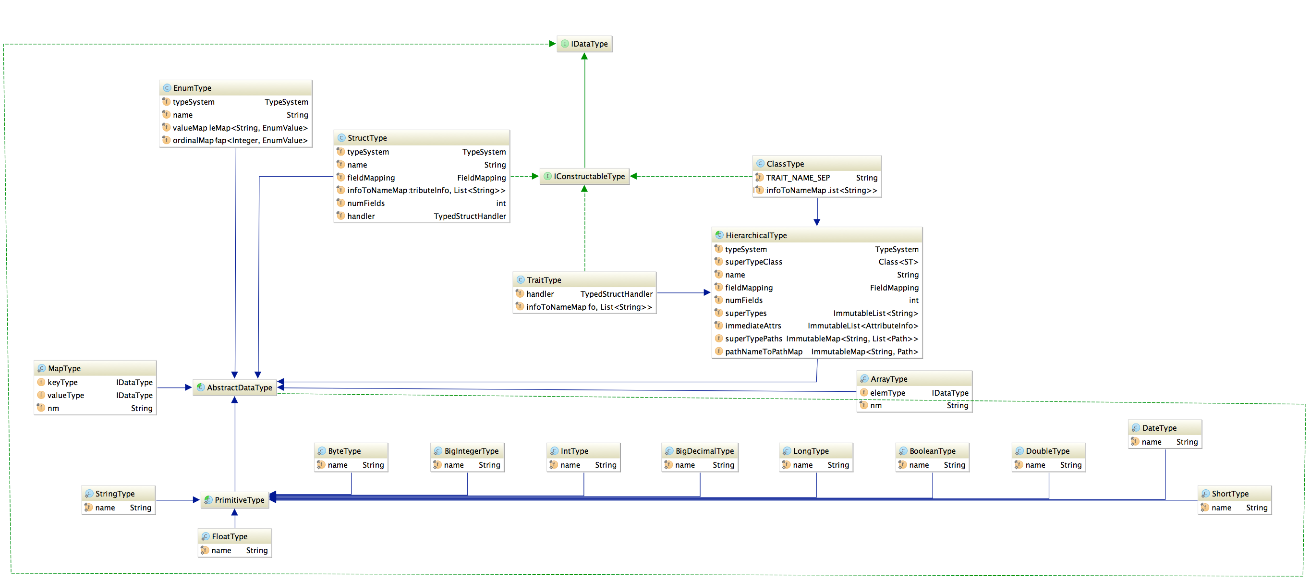
Type System – Data Types

Slide 18
_trait("Dimension") {}
_trait("PII") {}
_trait("Metric") {}
_trait("ETL") {}
_trait("JdbcAccess") {}
_class("DB") {
"name" ~ (string, required, indexed, unique)
"owner" ~ (string)
"createTime" ~ (int)
}
_class("StorageDesc") {
"inputFormat" ~ (string, required)
"outputFormat" ~ (string, required)
}
_class("Column") {
"name" ~ (string, required)
"dataType" ~ (string, required)
"sd" ~ ("StorageDesc", required)
}
_class("Table", List()) {
"name" ~ (string, required, indexed)
"db" ~ ("DB", required)
"sd" ~ ("StorageDesc", required)
}

Slide 19
Repository
Graph Database
Titan with storage backed by HBase
Types and instances are mapped to the Graph DB
Classes, Structs and Traits map to a vertex
Relationships are mapped as edges
Search - plugin enabled
Indexing based on type annotations
Solr
Elastic search

Slide 20
Search
DSL with SQL Like Syntax
from $type is $trait where $clause select|has $attributes loop $loopExpression withPath, repeat
Examples
from DB
DB where name="Reporting" select name, owner
DB has name
DB is JdbcAccess
Column where Column is a PII
Table where name="sales_fact", columns
Table where name="sales_fact", columns as column select column.name, column.dataType, column.comment
Full-text search

Slide 21
Lineage
Uses Search DSL Loop expression
Everything results in search
Named Queries
inputs
Table where (name = \"sales_fact_monthly_mv\") as src loop (LoadProcess->outputTable inputTables) as dest select src.name as src_name, dest.name as dest_name withPath
outputs
Table where (name = \"sales_fact\") as src loop (LoadProcess->inputTables outputTables) as dest select src.name as src_name, dest.name as dest_name withPath
schema
Table where name="sales_fact", columns

Slide 22
Hive Integration
Hive Bridge
(Client)
Hive Hook
(Post-execution)
REST API
Apache Atlas

Slide 23
Apache Atlas Screens

Slide 24
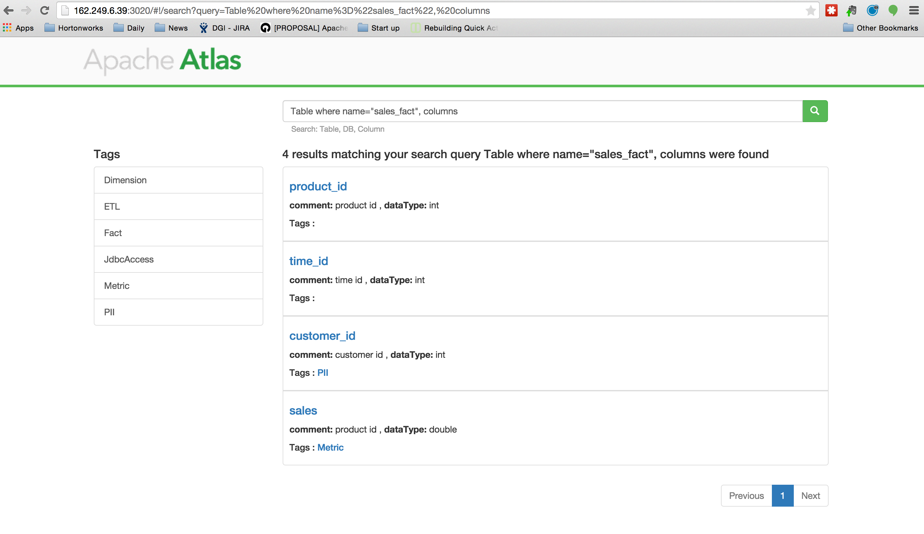

Slide 25
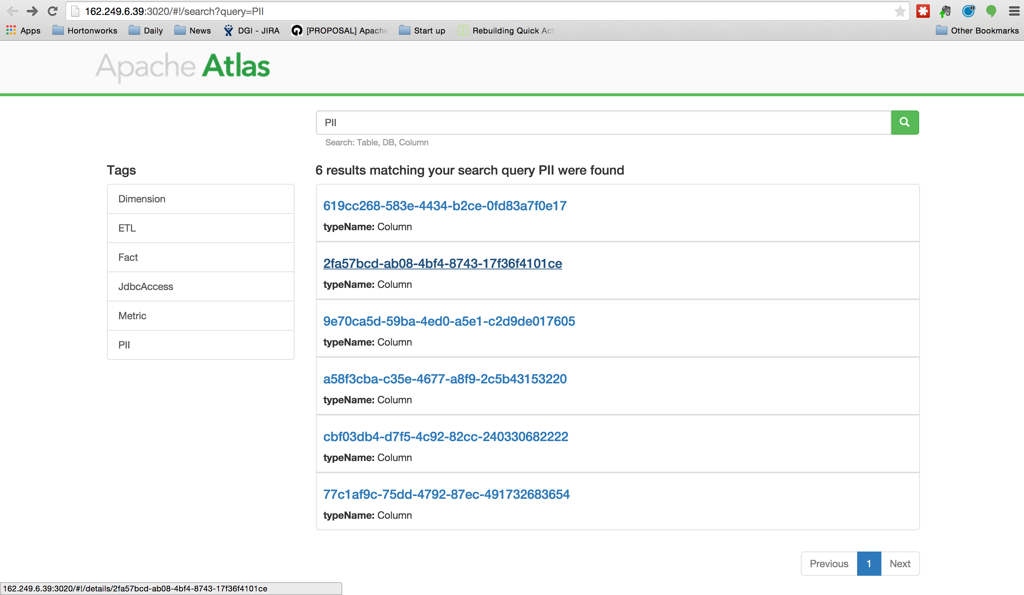

Slide 26
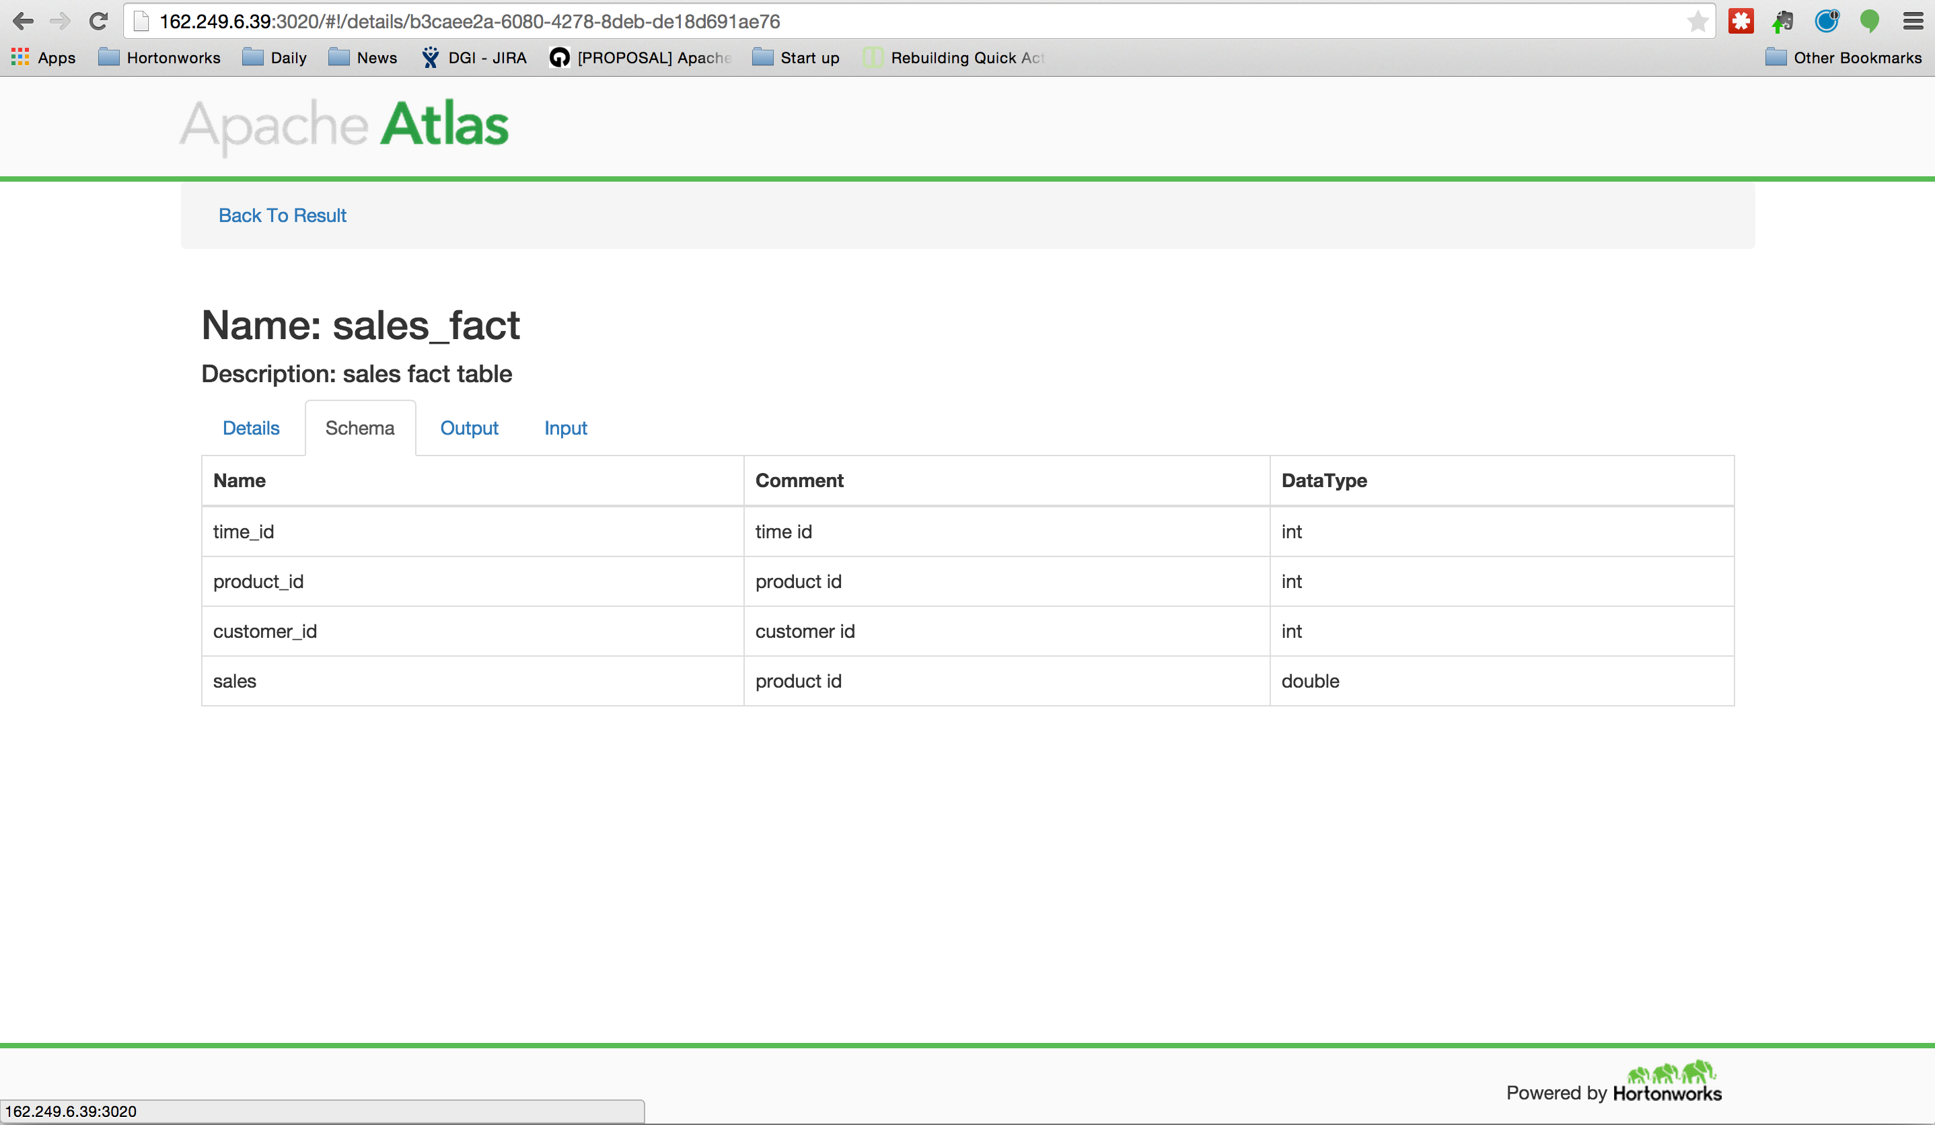

Slide 27
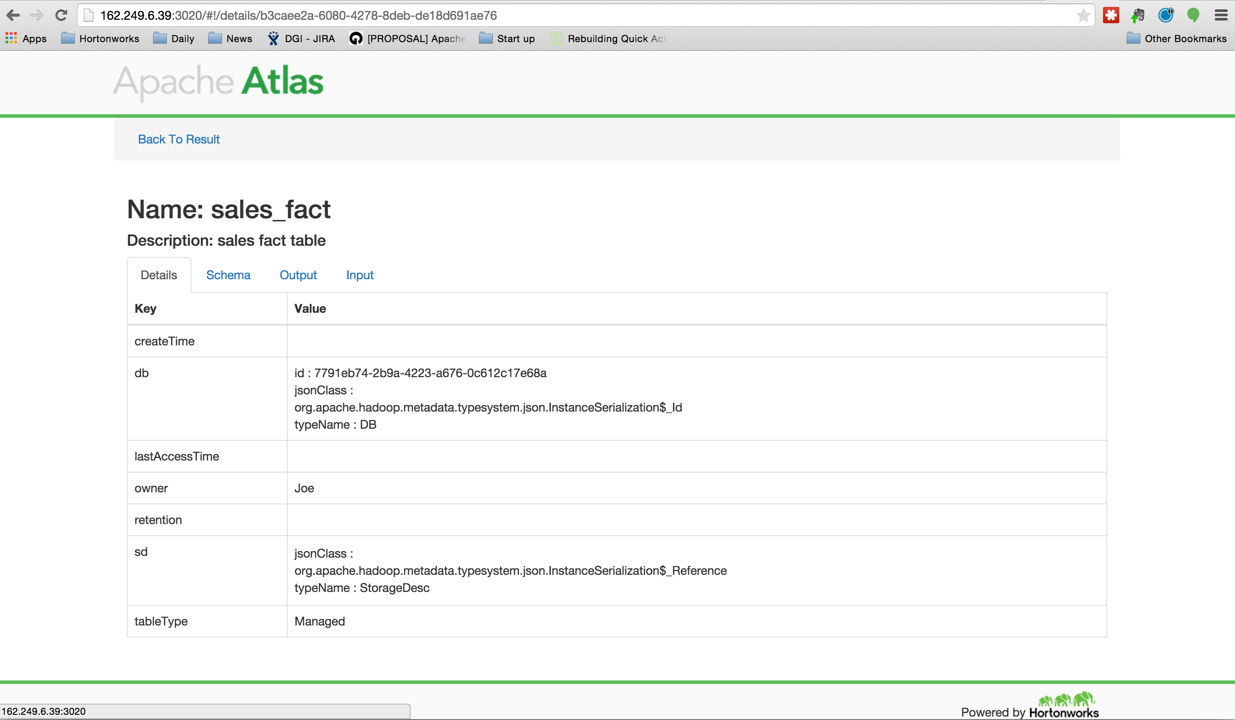

Slide 28
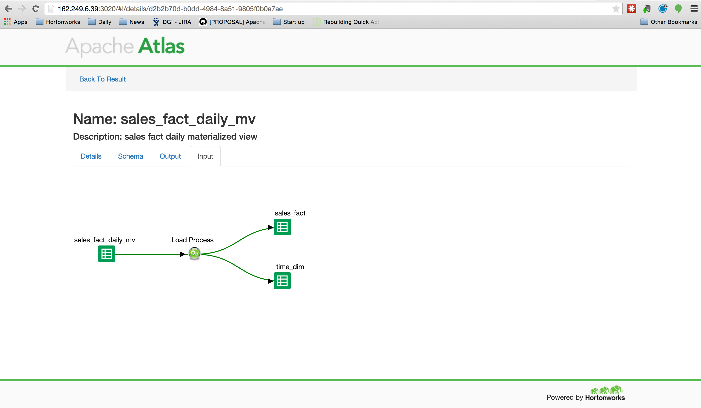

Slide 29
Demo Atlas

Slide 30
Atlas UI demostration
Search DSL
Type – DB, Table, Column
Tag - PII
Keyword
Results
Details
Schema
Lineage
Coming Features

Slide 31
Ingestion Demo Objective
Show Lineage with Sqoop Ingestion of data
Custom process instrumention
Use the Hive Hook CTAS Operation
Atlas Follow Lineage
Metadata Model in Atlas
The Open Framework
Create Custom Types
Create Custom Process
Sample Codes

Slide 32
Setup
Source System
MySQL Database
DRIVERS
TIMESHEET
Destination System
Single Node HDP 2.3 (Tech Preview)
Apache Atlas

Slide 33
Steps to Create Metadata
Create a Atlas Client Instance
Create Type Definitions
Class Types
Attributes
List the Types
Instantiate Entities
- Create Entities (Class Type)
- Search the Types
Create Process
Create DataSet Type
Create Process Type
Connect a Process Lineage

Slide 34
Attribute Definition
Name
Data Type
Multiplicity
Composite
isIndexable
ReverseAttribute

Slide 35
Questions and Answers

Slide 36
Atlas Resources
HDP 2.3 Preview Sandbox VM:
http://hortonworks.com/hdp/whats-new/
Apache Atlas:
http://atlas.incubator.apache.org/
http://incubator.apache.org/projects/atlas.html
https://git-wip-us.apache.org/repos/asf/incubator-atlas.git
Partner Workshops
http://hortonworks.com/partners/learn/
More to come with official GA release of HDP 2.3

Slide 37
Thank you !

